Slide 1
Multiplexed Proteomics:
Principle, Problems, and Solutions
Martin Wühr, January 2016

Slide 2


Isobaric labels enable multiplexed proteomics
*
*
*
*
*
*
*
*
*
*
TMT-126
TMT-127
For Multiplexed Proteomics the different conditions (channels) are encoded with different tags. Shown here are two different TMT-tags. The chemical structure is identical. The stars indicate heavy isotopes (C13 or N15). Unlike MS1 based quantitative proteomics the total number of heavy isotopes on these tags is identical (Thompson et al. 2003).

Slide 3

Isobaric labels enable multiplexed proteomics
*
*
*
*
*
*
*
*
*
*
TMT-126
TMT-127
MS1 Spectra
Target peptide
Peptides from multiple conditions (here two) are labeled with these tags which are indistinguishable in the MS1 spectrum as the peptides from different conditions will exhibit the same m/z values.
Isolation
window
Peptides
(ionized):
m/z

Slide 4
Isobaric labels enable multiplexed proteomics
*
*
*
*
*
*
*
*
*
*
TMT-126
TMT-127
MS1 Spectra
MS2 Spectra, TMT Reporter Ions
Upon fragmentation some of the tags will break at the indicated dashed black lines. Resulting are distinguishable low m/z reporter ions which can be used to read out the relative abundance of the original peptide in the MS2 spectrum. Importantly, unlike with MS1 based quantification, e.g. SILAC, the complexity of the MS1 spectrum does not increase with additional channels. Because of MS1 complexity SILAC limited to maximally ~3 channels. Multiplexed proteomics can compare 10 (commercially available) or even more channels (e.g. Braun et al. 2015) in a single experiment.
Target peptide
Isolate,
fragment TMT
with MS2
Isolation
window
Peptides
(ionized):
m/z
126
127

Slide 5
The problem of multiplexing: ratio distortion
*
*
*
*
*
*
*
*
*
*
TMT-126
TMT-127
MS1 Spectra
Target peptide
Unfortunately, the standard MS2 strategy with isobaric tags has an inherent quantification problem.
Isolation
window
Peptides
(ionized):
m/z

Slide 6
The problem of multiplexing: ratio distortion
*
*
*
*
*
*
*
*
*
*
TMT-126
TMT-127
MS1 Spectra
Target peptide
For technical reasons the isolation window which selects the peptide of interest for the MS2 spectrum has to be at least 0.5 m/z wide. When analyzing complex samples, like cell lysates, peptides with similar mass are nearly always co-isolated and co-fragmented.
Isolation
window
Peptides
(ionized):

Slide 7
The problem of multiplexing: ratio distortion
*
*
*
*
*
*
*
*
*
*
TMT-126
TMT-127
MS1 Spectra
MS2 Spectra, TMT Reporter Ions
Target peptide
These co-isolated peptides are labeled with the same isobaric tags and the resulting low m/z reporter ions are a combination of the peptide of interest and the “interfering” peptides. In real world samples the resulting ratios are therefore typically severely distorted (Ting et. al 2011, Wühr et al. 2012).
Isolate,
fragment TMT
with MS2
Isolation
window
Peptides
(ionized):
126
127
Observed ratio 1:1

Slide 8
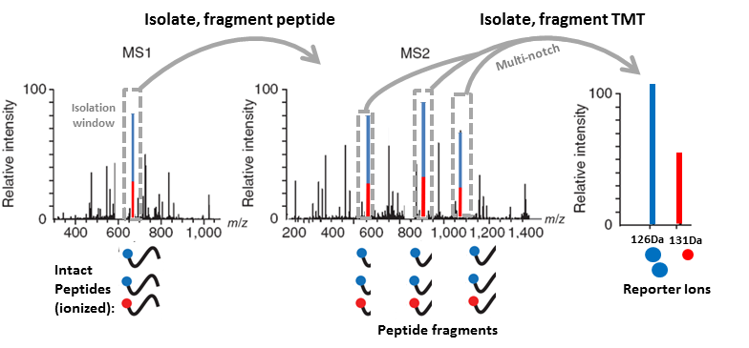
Solution 1: MultiNotch MS3
The Gygi lab recently developed two fundamentally different methods to overcome the interference problem for quantitative multiplexed proteomics. The first solution is called MultiNotch MS3 co-isolates and co-fragments multiple fragment ions from the MS2 spectrum. This additional isolation step further purifies the signal, and the resulting ratio is typically closer to the accurate ratio (Ting et al. 2011, McAlister et al. 2014)

Slide 9
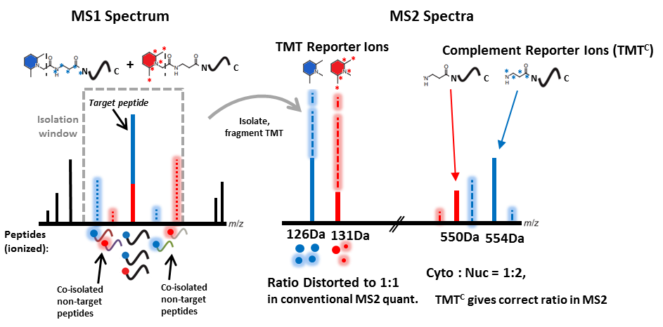
Solution 2: Complement reporter ion quantification (TMT^{C})
An alternative approach is to use the complement reporter ions for quantification. These ions, like the low m/z reporter ions, contain the quantitative information of relative abundance. However, unlike the low m/z reporter ions they have the inherent advantage that their m/z values are precursor specific. With high resolution mass analyzer like the Orbitrap we can easily distinguish the signal coming from the peptide of interest and signal coming from co-isolated and co-fragmented peptides (Wühr et al 2012).

Slide 10
Quantification for peptides with known ratios with TMT^{C}, TMT-MS3 or conventional TMT-MS2
Number of peptides
Fraction of signal from peptide of interest
Here is a standard where yeast peptides labeled with TMT131 where added to human peptides labeled with TMT-126. For the yeast peptides we can calculate what fraction of the quantified signal comes from the peptide of interest (TMT-131) or from interfering human peptides (TMT-126). When peptides are quantified with standard MS2 method a large fraction of signal is from interferering peptides (The true answer for all yeast peptides is 1). With MultiNotch MS3 quantification interference is further suppressed. Quantification with the complement reporter ion cluster provides us with the most accurate measurement. Recent progress with this method makes it also significantly more sensitive than the MS3 method.

